Slide 1
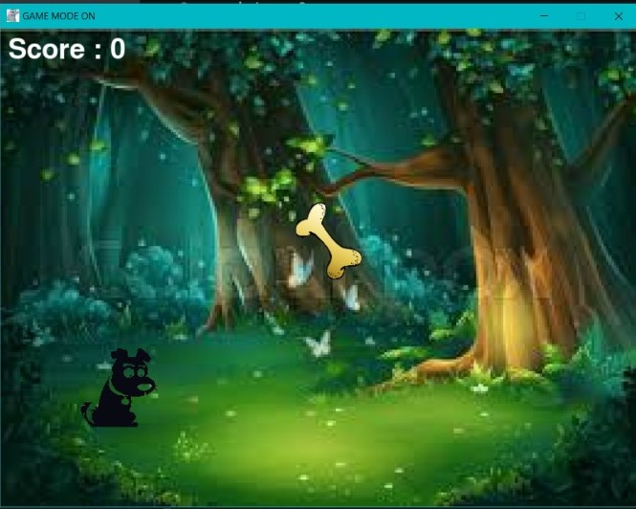
THE HUNGRY DOG
By HackerGirls
Team Members Name:
Priyanshi Agarwal
Yukti Kumari
Jyoti Anjaly
Supriti Das
Team number: 082

Slide 2
INTRODUCTION
We have developed a game “THE HUNGRY DOG”
Sole purpose of this project is Entertainment. As We all know, People are getting busy in their life and they have no time to relax. So, our purpose is to entertain them. This game can be played by all age groups.
This game is created by using python only.

Slide 3
ABOUT GAME
The Game contains a Dog, a few bones and bullets. Dog tries shooting bullets on the bones.This game is a time limited game. Player will get only one minute to score the maximum points, he/she can. On hitting the bone, it will disappear and a new bone will drop from the sky. And if the player fails to hit the bone, it will reach to the ground and disappear. Once, the game is over, your score will be displayed.

Slide 4
HOW TO PLAY
For moving the dog in forward direction use right arrow and in backward direction use left arrow.
For shooting a bullet on the bone, use space bar.
Each time, bullet hits the bone, player scores +5 points.

Slide 5
THANK YOU!
The End!

